Slide 1
Recent Cyber Security Events and Future Research Directions
Robert Mitchell rrmitch@sandia.gov

Slide 2
Agenda
Where I Work
Recent Cyber Security Events
Future Research Directions

Slide 3
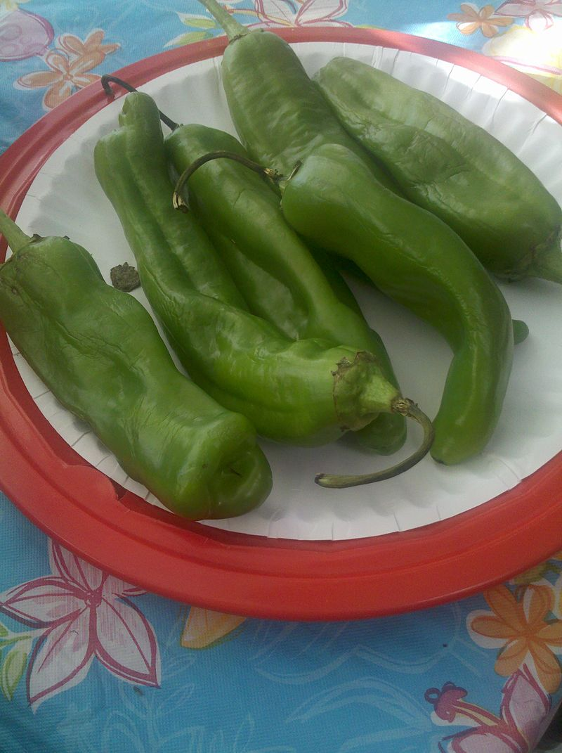
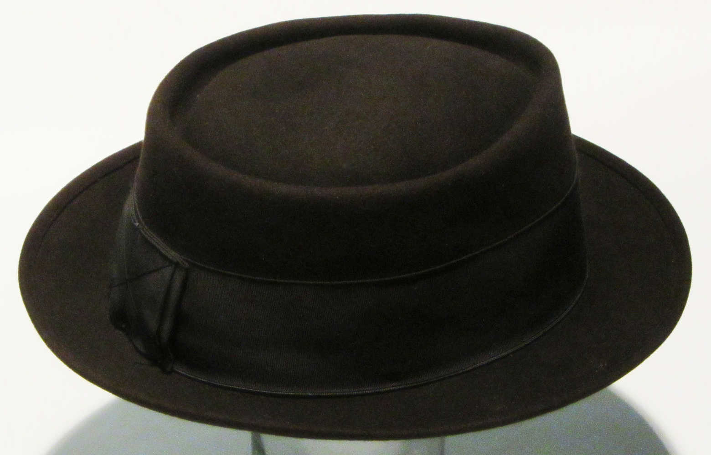
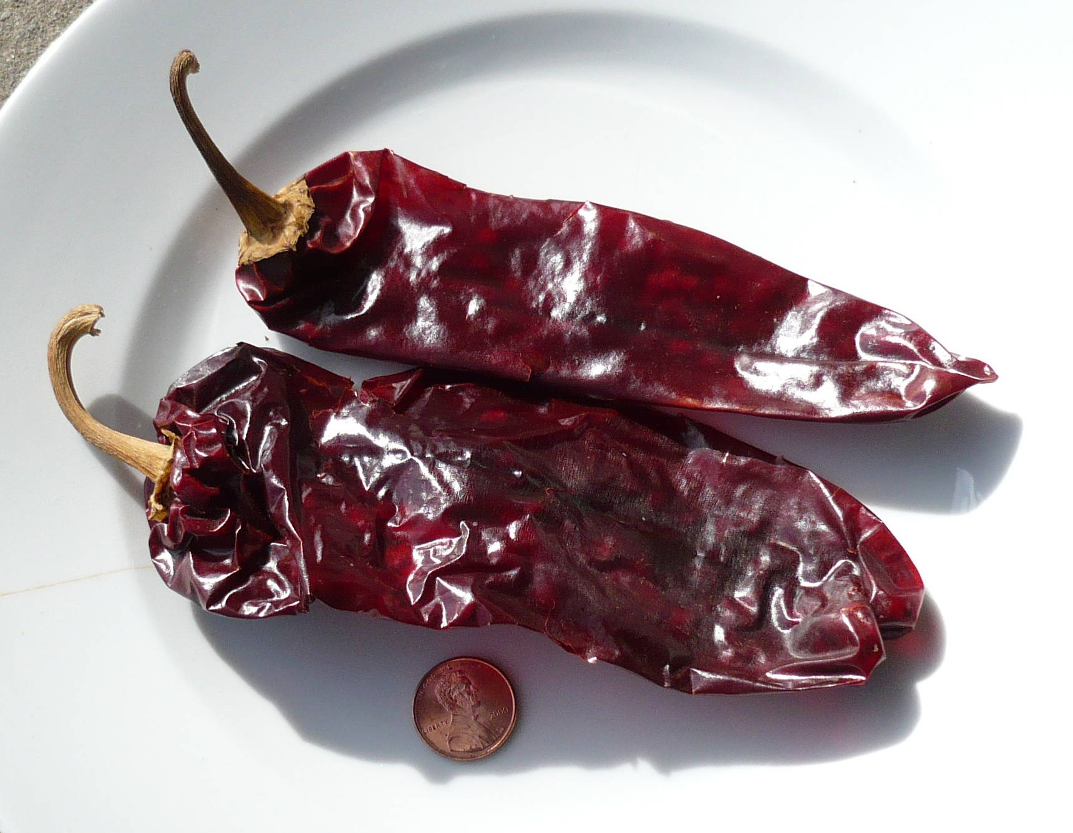
Where I Work

Slide 4
Recent Cyber Security Events
Ukraine Power Grid Attack
United States Democratic National Committee Hack
Banner Health Privacy Spill
Dyn Domain Name System Distributed Denial of Service
San Francisco Municipal Transportation Agency Ransom

Slide 5
Ukraine Power Grid Attack
December 2015
Computer network attack (CNA)
State sponsored
230,000 customers lose power for up to 6 hours
Supervisory Control and Data Acquisition (SCADA) target
BlackEnergy and KillDisk
Cyber warfare units are the new little green men
Malware recycling disrupts attribution

Slide 6
United States Democratic National Committee Hack
Two campaigns began in Summer 2015 and April 2016
Computer network exploitation (CNE)
State sponsored
Interfered with the election of the leader of 319M people
Sea Daddy, X Agent and X-Tunnel
Sometimes state sponsored actors make mistakes

Slide 7
Banner Health Privacy Spill
June 2016
Computer network exploitation (CNE)
Criminal
Privacy of 3.7M customers compromised
Payment data and protected health information spilled
Flat networks are weak
Know your risk ($37M)

Slide 8
Dyn Domain Name System Distributed Denial of Service
October 2016
Computer network attack (CNA)
Ideologue or weapons test
Counter-attribution effort
Many high profile servers had no DNS for 6 hours
Mirai
Fan-in concept
Bots could have accessed private data

Slide 9
San Francisco Municipal Transportation Agency Ransom
November 2016
Computer network attack (CNA)
Criminal
$1,591,782 loss = 707,459 free rides × $2.25 average fare
HDDCryptor
Fan-out concept
Ransomware
Muni restored from backup instead of paying

Slide 10
Future Research Directions
Adjacent Disciplines
Topics
Ransomware
Internet of Things
Intrusion Tolerance
Attribution
Methods
Real Data Sets
Empiricism
Canonical, Complete and Orthogonal Metrics
Human Subject Research

Slide 11
Adjacent Disciplines
All research areas are adjacent
Security is everyone’s business
Don’t become famous for the wrong reason
Serial servers
This institution is leading the way

Slide 12
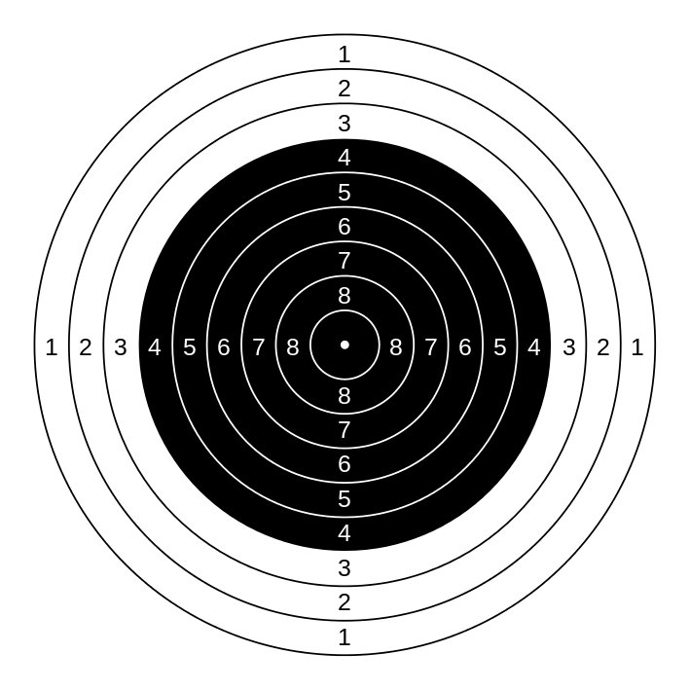
Topics

Slide 13
Topics: Ransomware
Challenges
Victims are paying
Fast, strong encryption
Intuitive solution
Opportunities
Optimize restores
Prevent encryption
Attribution
Related topics
Cloud computing
Dynamic platform techniques

Slide 14
Topics: Internet of Things
Challenges
Can be repurposed
Life-critical Things
Limited resources
Oligoculture
Patch rollout
Forgotten hosts
Privacy
Opportunities
Purpose-built devices are easy to profile
Purpose-built devices are easy to lock down
Physical access can enhance authentication

Slide 15
Topics: Intrusion Tolerance
Challenges
Optics
Increases friction for legitimate users
Existing work is mostly intrusion response
Opportunities
Related topics
Cyber zone defense
Moving target defense
Disrupt unseen attacks
Establish resilience as a metric

Slide 16
Topics: Attribution
Challenges
CNA adversaries
Network-based indicators
Attackers can tidy up
Antagonists can change techniques
Recycling programs
Opportunities
CNE adversaries
Host-based evidence
Snap artifacts before attackers pick them up
Extract features from artifacts and tradecraft
Reduce asymmetry

Slide 17
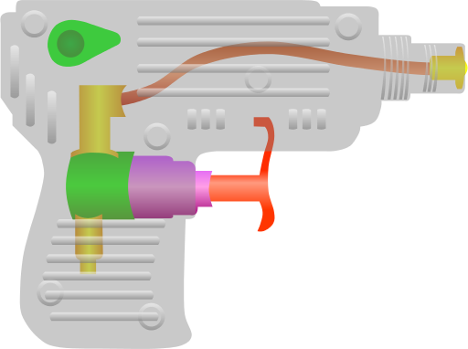
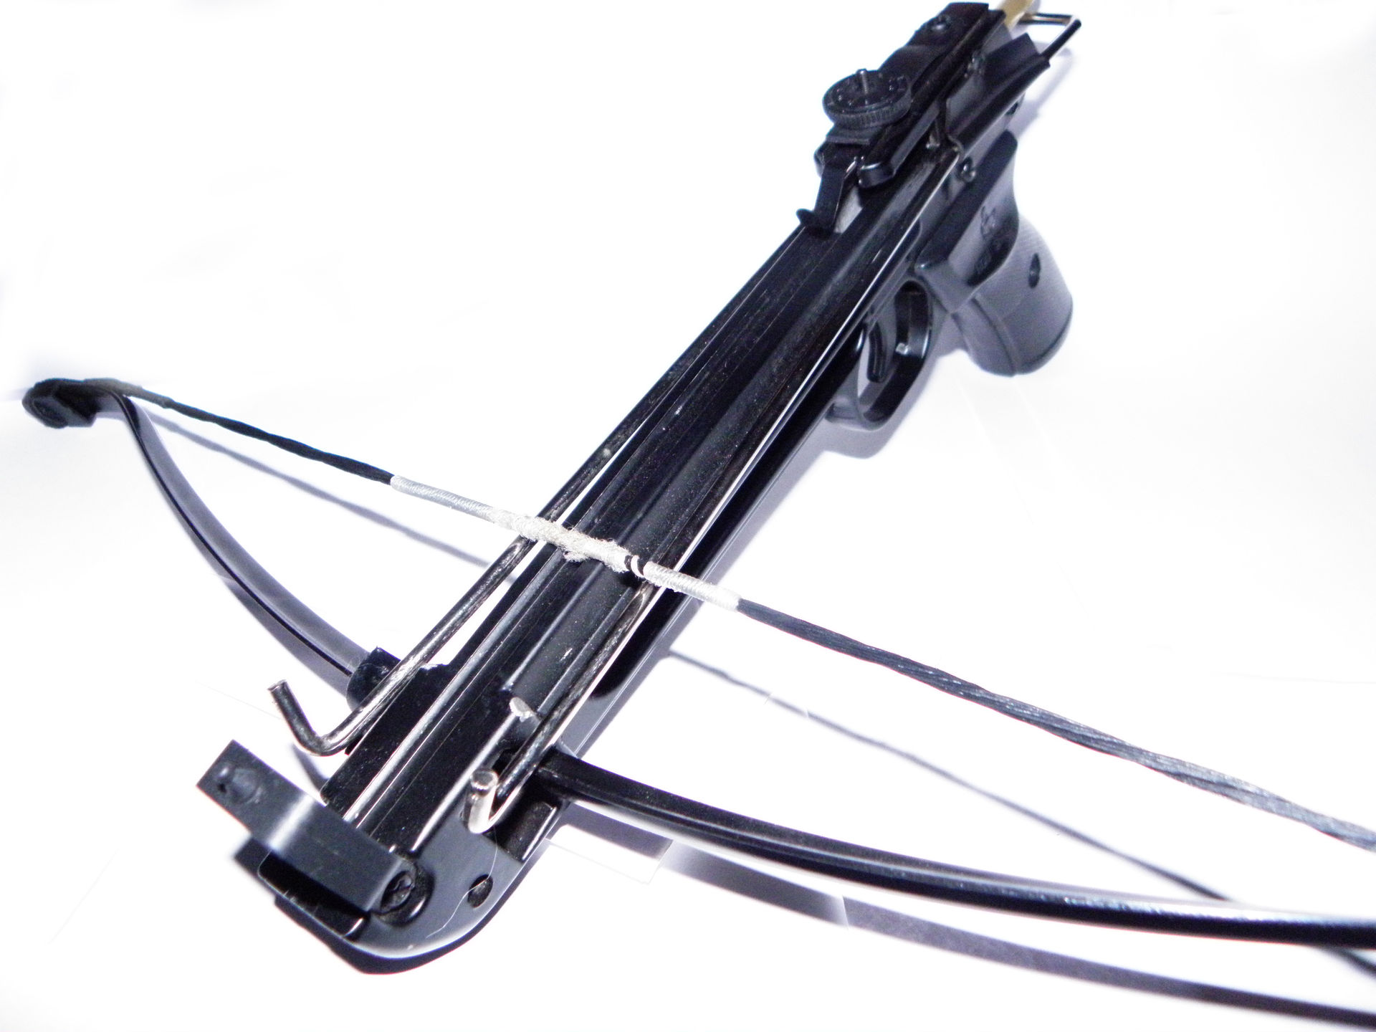
Methods

Slide 18
Methods: Begin with Real Data
Challenges
Some institutions won’t share
Publicly-traded companies
Governments
Professional attackers won’t play
Opportunities
Some institutions will share
National laboratories
Universities
Pen testers will play

Slide 19
Methods: Empiricism
Challenges
Derive models
Instrument simulations
Carry out experiments
Opportunities
Statistical analysis
Compare related studies
Visualize relationships

Slide 20
Methods: Canonical Metrics
Challenges
Measure the attacker
Measure the defender
Achieve consensus
Opportunities
Support practitioners
Meta-analysis

Slide 21
Methods: Human Subject Research

Slide 22
Methods: Human Subject Research
Challenges
Institutional review boards
Humans are hard to measure
Interdisciplinary research is hard
Opportunities
Bypass Whac-A-Mole
External validation and generalizability
Linkography
Detect cyber rangers who “live off the land”

Slide 23
Outro
Where I Work
Recent Cyber Security Events
Future Research Directions

Slide 24
Recent Cyber Security Events and Future Research Directions
Robert Mitchell rrmitch@sandia.gov

