Slide 1


Using Machine Learning to Forecast Student Outcomes
Drew Wham
Teaching and Learning with Technology
Notes:
Topic areas
How we were first exposed to data science
Where we are now, highlighting our large project
Where we can go in the future

Slide 2
Talk Outline
Scope and Motivation of Work
Methodology
System Architecture
Hardware and Software
Machine Learning Algorithms
Modeling Results
Making Results Actionable
Questions
Notes:
Topic areas
How we were first exposed to data science
Where we are now, highlighting our large project
Where we can go in the future

Slide 3
What if we used the latest statistical methods on institutional data to support the decision processes around learning?
Notes:
Topic areas
How we were first exposed to data science
Where we are now, highlighting our large project
Where we can go in the future

Slide 4
“Machine Learning”
What if we used the latest statistical methods on institutional data to support the decision processes around learning?
Notes:
Topic areas
How we were first exposed to data science
Where we are now, highlighting our large project
Where we can go in the future

Slide 5
“Machine Learning”
Artificial Intelligence
What if we used the latest statistical methods on institutional data to support the decision processes around learning?
Big
Notes:
Topic areas
How we were first exposed to data science
Where we are now, highlighting our large project
Where we can go in the future

Slide 6
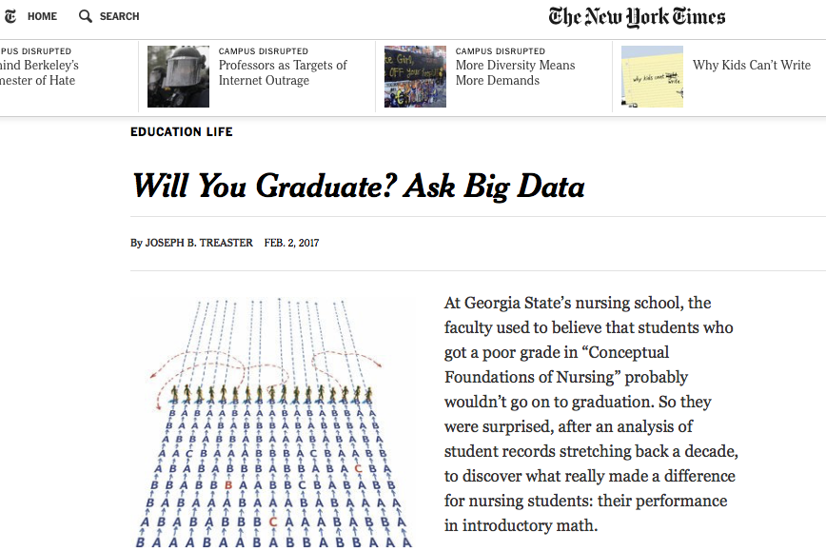
“Machine Learning”
Artificial Intelligence
What if we used the latest statistical methods on institutional data to support the decision processes around learning?
Big
Notes:
Topic areas
How we were first exposed to data science
Where we are now, highlighting our large project
Where we can go in the future

Slide 7
“Machine Learning”
Artificial Intelligence
What if we used the latest statistical methods on institutional data to support the decision processes around learning?
Big
Notes:
Topic areas
How we were first exposed to data science
Where we are now, highlighting our large project
Where we can go in the future

Slide 8
What if we used the latest statistical methods on institutional data to support the decision processes around learning?
Great idea!
Notes:
Topic areas
How we were first exposed to data science
Where we are now, highlighting our large project
Where we can go in the future

Slide 9
What if we used the latest statistical methods on institutional data to support the decision processes around learning?
Great idea!
What could possibly go wrong!
Notes:
Topic areas
How we were first exposed to data science
Where we are now, highlighting our large project
Where we can go in the future

Slide 10
What if we used the latest statistical methods on institutional data to support the decision processes around learning?
Great idea!
What could possibly go wrong?
Notes:
Topic areas
How we were first exposed to data science
Where we are now, highlighting our large project
Where we can go in the future

Slide 11
What could possibly go wrong?
-Privacy
-Algorithmic Bias
-Misinterpretations
-Black Box
-Snake Oil
Notes:
Topic areas
How we were first exposed to data science
Where we are now, highlighting our large project
Where we can go in the future

Slide 12

What could possibly go wrong?
-Privacy
-Algorithmic Bias
-Misinterpretations
-Black Box
-Snake Oil
Poison
Notes:
Topic areas
How we were first exposed to data science
Where we are now, highlighting our large project
Where we can go in the future

Slide 13
What could possibly go right?
-Informed Decisions
-Better use of Resources
-Discover Institutional Biases
-Create Better Intervention Strategies
Notes:
Topic areas
How we were first exposed to data science
Where we are now, highlighting our large project
Where we can go in the future

Slide 14

What could possibly go right?
-Informed Decisions
-Better use of Resources
-Discover Institutional Biases
-Create Better Intervention Strategies
Notes:
Topic areas
How we were first exposed to data science
Where we are now, highlighting our large project
Where we can go in the future

Slide 15

Research Objective:
Develop University scale Machine Learning Systems to enable research on them.
Notes:
This might work better in an appendix, and verbally described while on the animal slide. Hannah - don’t worry about treating this with visuals if time is short.
Robust to the differences in data quality and coverage between students and across time
Robust to the differences in relative importance of features between different classes and for different students

Slide 16
Research Objective:
Develop University scale Machine Learning Systems to enable research on them.
-How accurate could/should they be?
-Are there biases? Can we fix that?
-What parts are Hard? Easy?
-How do individuals use the information?
Notes:
This might work better in an appendix, and verbally described while on the animal slide. Hannah - don’t worry about treating this with visuals if time is short.
Robust to the differences in data quality and coverage between students and across time
Robust to the differences in relative importance of features between different classes and for different students

Slide 17



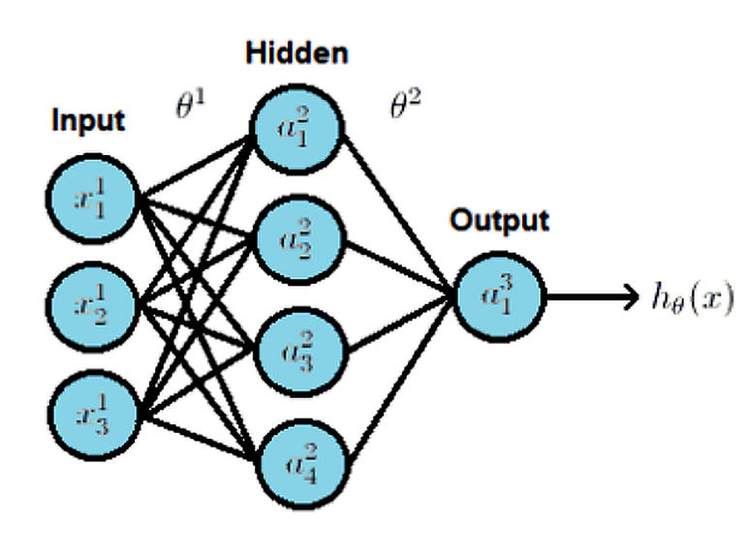


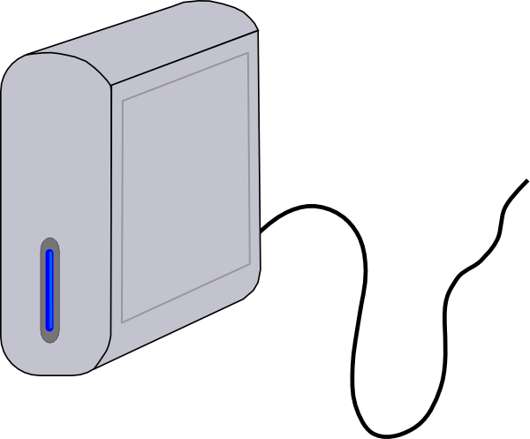
Data Science Pipeline
Warehouse
Angel
Starfish
Many Other Sources
LionPath
Canvas
IRR
Learning Data-Sphere
1) New data format
Scripts/Programs for automating data retrieval
2) Models
Past and Current Data
Current Data
Intel 6-core 3.40GHz CPU
32GB RAM
2x Nvidia 1080 ti
Artificial Intelligence API
UI Web Application
High Performance Computer

Slide 18
The Forecast Model: Predict student outcomes before courses begin based on historical data and the students proposed schedule.
Potential Model Endpoint: Enable coarse scheduling decisions when outcomes are a limiting concern
Notes:
This fits all 3 from slide 4
1: There are many small decisions being made by a distributed set of decision makers
2: The optimal decision is uncertain. There is no singular "right answer" that is broadly applicable
3: Historical data surrounding the process is available

Slide 19
The Forecast Model
Be scalable and accurate
Predict every student-course combination possible at the university
Predicts grades (0-4 gpa) and the probability of WD (0-1)
Consider history of the individual Student, the individual Course and effects of the full schedule (course load)
Notes:
This might work better in an appendix, and verbally described while on the animal slide. Hannah - don’t worry about treating this with visuals if time is short.
Robust to the differences in data quality and coverage between students and across time
Robust to the differences in relative importance of features between different classes and for different students

Slide 20
Data
~20,000,000 outcomes between 2005-Now
For every enrollment: Course name, student ID and Grade (A, A-, B+, B, B-, C, D, F) or W
Student: HS GPA, HS class rank, AP exam scores, SAT Math and Verbal, entrance and placement exam scores, Current GPA, Previous Semester GPA, gender, age, Birth Year, Credits Enrolled, credits earned…
Notes:
Student: HS GPA, HS class rank, AP exam scores, SAT Math and Verbal, entrance and placement exam scores, Current GPA, Previous Semester GPA, gender, age, Birth Year, Credits Enrolled, credits earned
Course: (all rolling over the past 5 years) Number of students, Avg GPA, Avg WD frequency, Avg GPA incoming, Avg SAT Math and Verbal, Avg number of credits earned
Relative Stats: The difference between course and student statistics
Course Distributed Representation
Course Difficulty Model: Individual Course plus the sum of the full schedual

Slide 21
Data Science Pipeline
Warehouse
Angel
Starfish
Many Other Sources
LionPath
Canvas
IRR
Learning Data-Sphere
1) New data format
Scripts/Programs for automating data retrieval
2) Models
Past and Current Data
Current Data
Intel 6-core 3.40GHz CPU
32GB RAM
2x Nvidia 1080 ti
Artificial Intelligence API
UI Web Application
High Performance Computer

Slide 22
Engineered Features
Course History: (rolling over the past 5 years) Number of students, Avg GPA, Avg WD frequency, Avg cumulative GPA, Avg SAT Math and Verbal, Avg number of credits earned
Relative Stats: The difference between course and student statistics
Course Distributed Representation
Effective Course Difficulty Model: Individual Course plus the sum of the full schedule
Notes:
Student: HS GPA, HS class rank, AP exam scores, SAT Math and Verbal, entrance and placement exam scores, Current GPA, Previous Semester GPA, gender, age, Birth Year, Credits Enrolled, credits earned
Course: (all rolling over the past 5 years) Number of students, Avg GPA, Avg WD frequency, Avg GPA incoming, Avg SAT Math and Verbal, Avg number of credits earned
Relative Stats: The difference between course and student statistics
Course Distributed Representation
Course Difficulty Model: Individual Course plus the sum of the full schedual

Slide 23
Forecast Model Overview
Rolling 5 year Engineered Features
XGBoost Model
Course Embedding's
Predict
Strength/Difficulty of Schedule Model
Student Data
2005-2009 Data
2010-2015 Data
2016 Data
Feature Engineering
Feature Engineering & Training
Test & Validation

Slide 24
Course Embeddings
Wide Neural Network: 2 layers, 100 nodes
Trained on course sequence data from 2005-present
Export a matrix of activations of each node for each course
Transform that matrix with t-SNE for visualization
https://plot.ly/~fcw5014/2.embed?share_key=ddXhDn7zficnzaOAHkH6e3
Notes:
Student: HS GPA, HS class rank, AP exam scores, SAT Math and Verbal, entrance and placement exam scores, Current GPA, Previous Semester GPA, gender, age, Birth Year, Credits Enrolled, credits earned
Course: (all rolling over the past 5 years) Number of students, Avg GPA, Avg WD frequency, Avg GPA incoming, Avg SAT Math and Verbal, Avg number of credits earned
Relative Stats: The difference between course and student statistics
Course Distributed Representation
Course Difficulty Model: Individual Course plus the sum of the full schedual

Slide 25
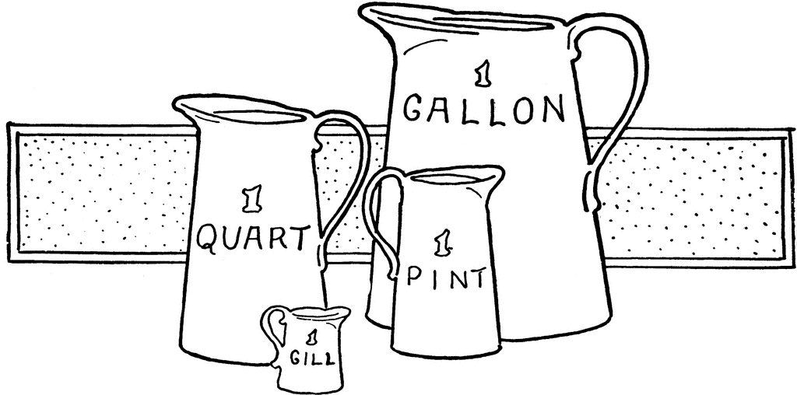
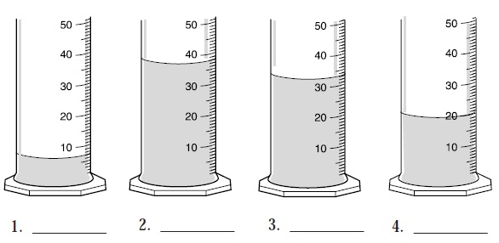
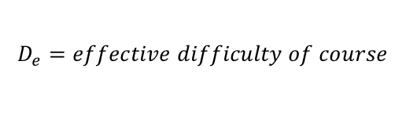
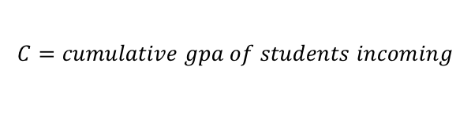
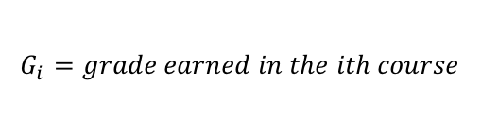

Effective Course Difficulty Model
$$D_{e} \sim (5+\overline{C}−\overline{G_{i}})var(G_{i})$$
$$D_{e}=effective difficulty of course$$
$$C=cumulative gpa of students incoming$$
$$G_{i}=grade earned in the ith course$$
KINS_077
Math_141
Chem_110
ACCTG_200
Students
Courses

Slide 26
Total Credits vs Effective Schedule Difficulty

Slide 27

XGBoost: Machine Learning Model
Gradient Boosted Tree Algorithm, ~1,500-2,000 decision trees
Objective function: GPA= Linear Regression, WD= Logistic Regression
Evaluation Metric: GPA= Root Mean Squared Error, WD= Log loss

Slide 28
Forecast Model Accuracy
62%

Slide 29
Forecast Model Accuracy
84%

Slide 30
The GPA Scale is Weird
0
1.0
2.0
2.3
2.7
3.0
3.3
3.7
4.0
F
D
C
C+
B-
B
B+
A-
A

Slide 31
Forecast Model Accuracy
87%

Slide 32
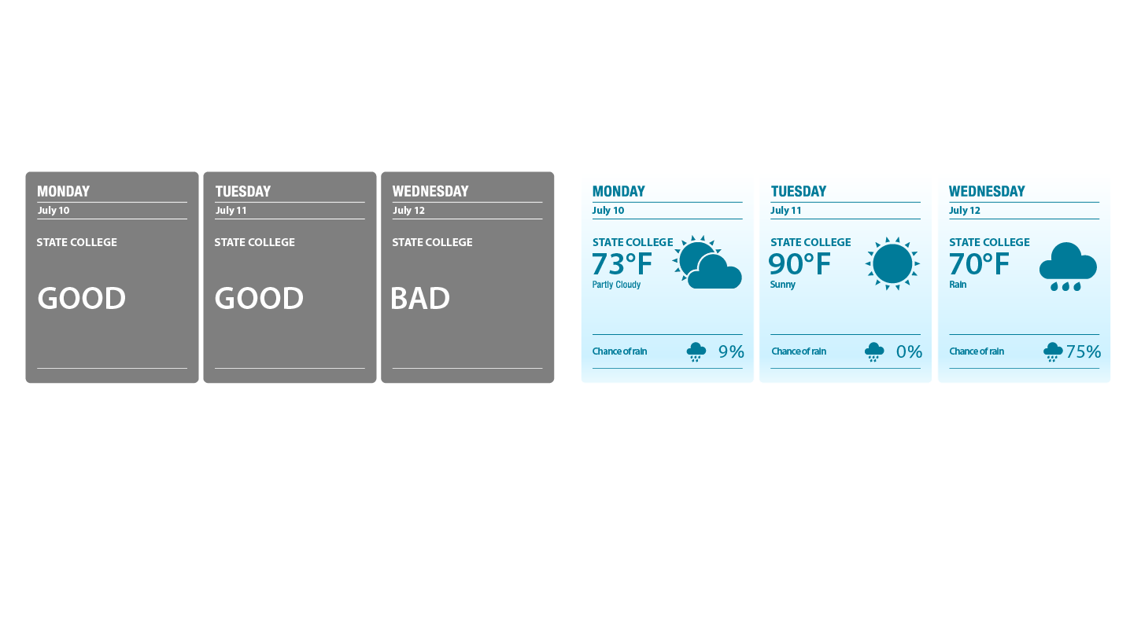
Advantages of our Approach over Risk Metrics
Other Approaches
Our Approach
Often based on 0-1 risk metric
Group D, F and W as “at risk”
Based on two different risk metrics
Splits Grades and Withdrawal

Slide 33
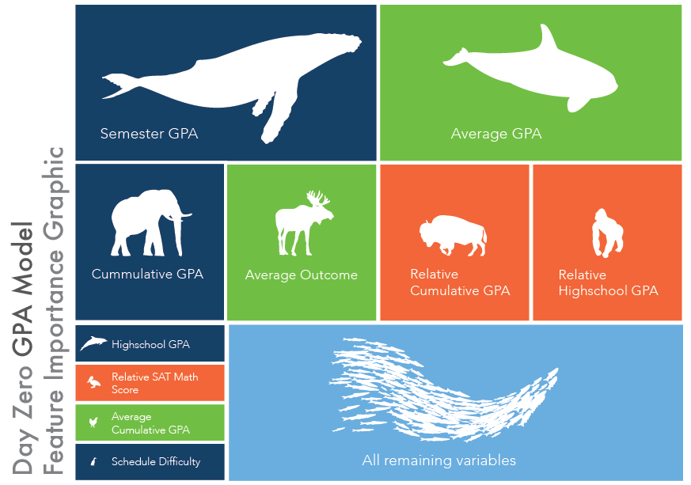
Notes:
Blue boxes: Anything related to the student
Green boxes: Anything related to the course
~ supervised machine learning > Classification regression tree > gradient boosted tree
~2000 trees, each one with up to 10 branches.
~45 variables in the model

Slide 34
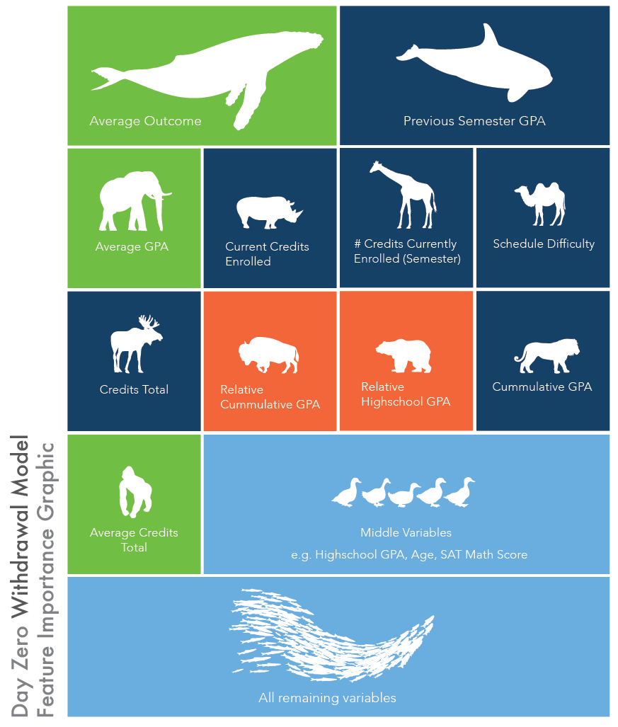

Slide 35
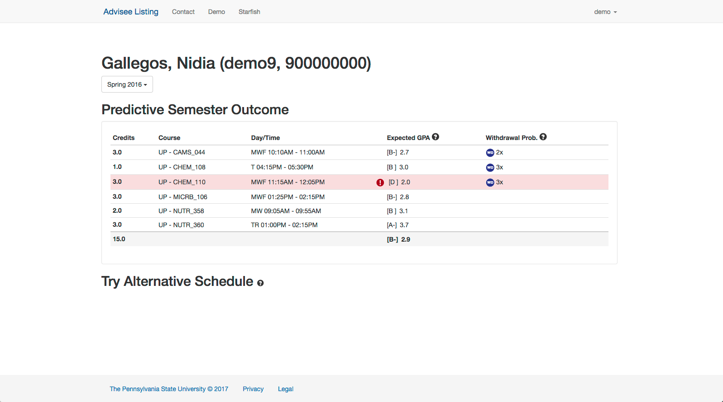
?
?

Slide 36
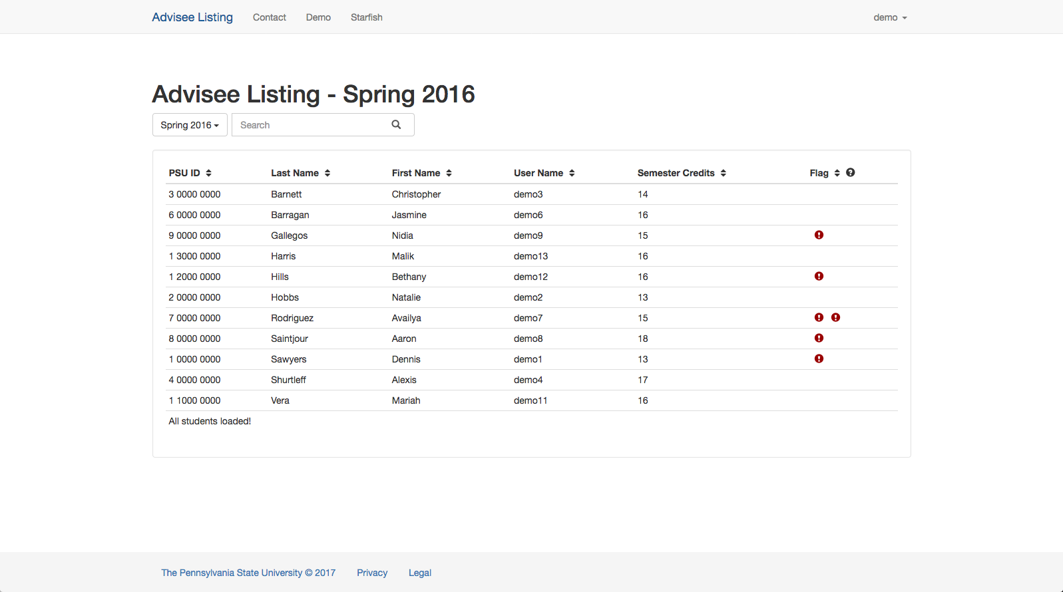
Notes:
Fall 2015 and spring 2016 used for validation. Model believes it is January 1st, 2016 when showing Spring 2016 data.

Slide 37
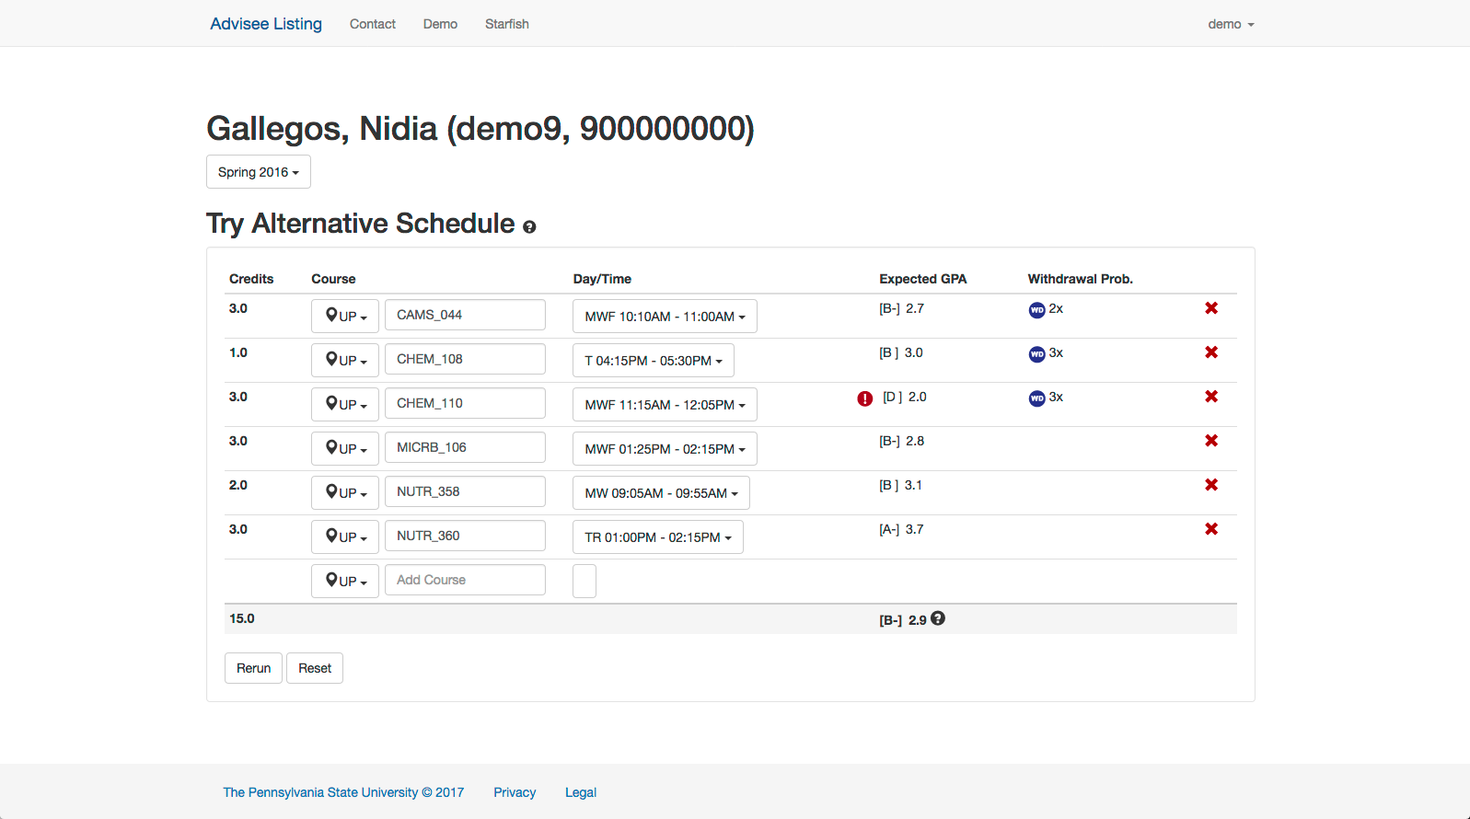
Notes:
Taking that into account an advisor has many options at their disposal to address this. One of those options might simply be that knowing that this course is going to be difficult the advisor and student could have a conversation about learning support opportunities around campus for this class (office hours, tutors ….). This allows the advisor to have a proactive discussion with the student before the semester starts rather than reactively meeting after the student has made a poor grade on the first test.
Alternatively, the student and advisor may decide that this course might be better to take in their sophmore year after they have developed better student/learning habits and skills. In this case the advisor can “try an alternative schedule

Slide 38
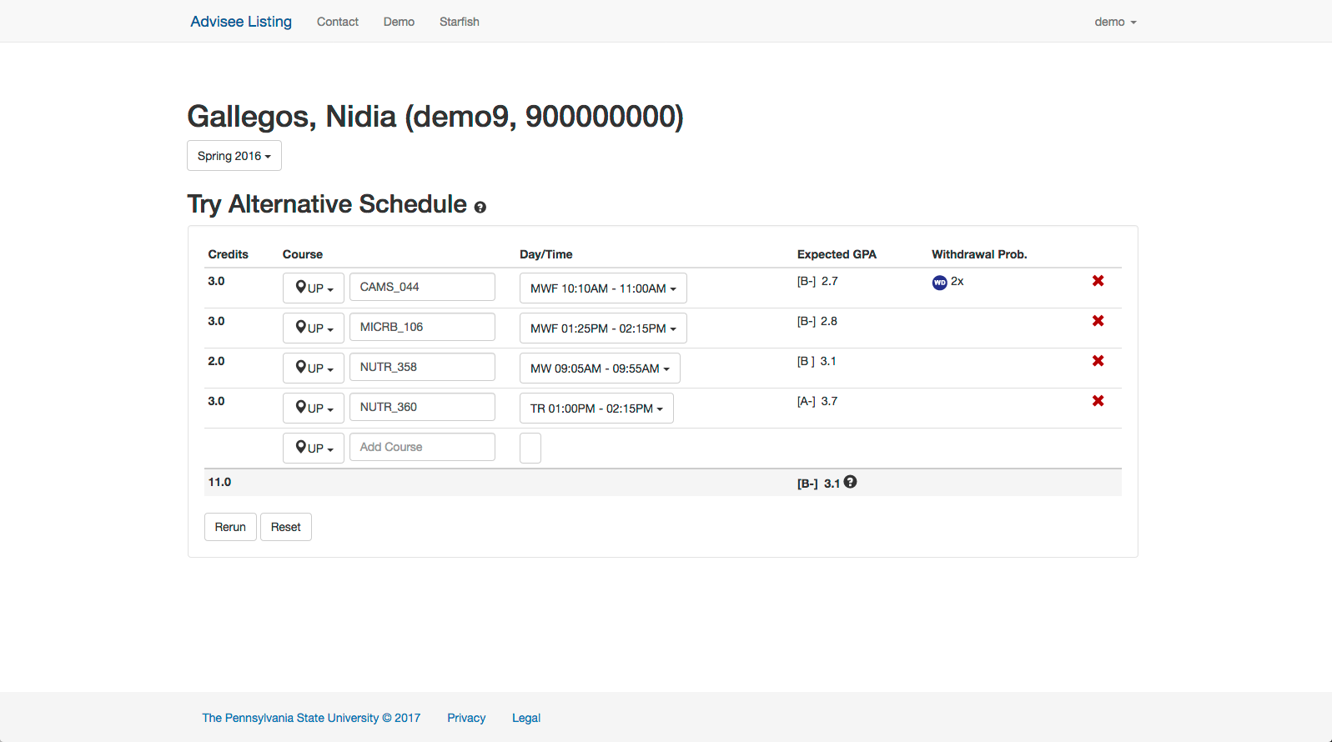

Slide 39

Notes:
As an example, the student may be better served taking MATH 110 which would still progress the student towards their degree while allowing the student to develop skills in the meantime that might help them succeed in them 110 when they do take it.

Slide 40
Conclusions
There are serious potential hazards, we need the ability to research applications on many levels
Students make mistakes in course load and course progression frequently
Enable pro-active, rather than re-active, intervention
Huge potential value if done correctly
Notes:
This might work better in an appendix, and verbally described while on the animal slide. Hannah - don’t worry about treating this with visuals if time is short.
Robust to the differences in data quality and coverage between students and across time
Robust to the differences in relative importance of features between different classes and for different students

