Slide 1
Getting Started: XSEDE Comet
Shahzeb Siddiqui - sms5713@psu.edu
Software Systems Engineer
Office: 222A Computer Building
Institute of CyberScience
May x^{th} 2015

Slide 2
System Overview
Comet is one of the XSEDE cluster designed by Dell and SDSC that delivers 2.0 PFLOPS of performance.
The system was available on XSEDE early 2015
Features include: next gen processor with AVX2, Mellanox FDR InfiniBand interconnect, and Aeon storage
San Diego Supercomputer Center (SDSC) at University of California was awarded $12 million grant from NSF to build a petascale supercomputer Comet

Slide 3
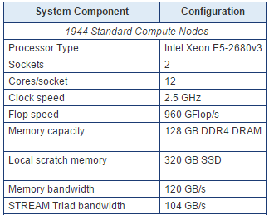
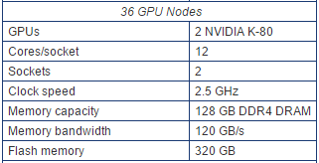
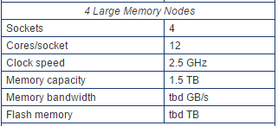
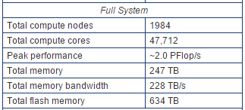
System Specification

Slide 4
Software Environment
OS: CentOS
Cluster Management: Rocks
File System: NFS, Lustre
Scheduler: SLURM
User Environment: Modules
Compilers: Intel, PGI Fortran/C/C++
MPI: Intel MPI, MVAPICH, OpenMPI
Debugger: DDT
Performance IPM, mpiP, PAPI, TAU

Slide 5
Accessing Comet
Requirement:
XSEDE account
Submit proposal through XSEDE Allocation Request System
Hostname: comet.sdsc.xsede.org
Comet supports Single Sign On (SSO) through XSEDE User portal
XSEDE SSO is a single point of entry to all XSEDE systems
To login to XSEDE portal
ssh <xsede-id>@login.xsede.org
To access comet from XSEDE portal
gsissh –p 2222 comet.sdsc.xsede.org
There are four login nodes when you access Comet: comet-ln[1-4].sdsc.edu

Slide 6
Environment Module
Environment Module provides a method for dynamically changing the shell environment to use different software
Few default modules are loaded at login including MVAPICH implementation of MPI and Intel compiler
Its recommended to use MVAPICH and Intel Compiler for running MPI-based application to achieve the best performance

Slide 7
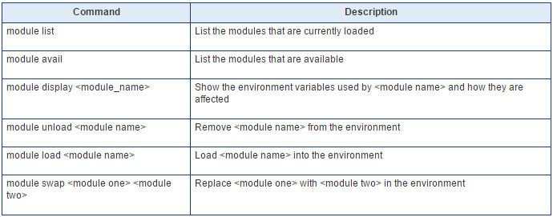
Module Command Options

Slide 8
Account Management & Charging
All jobs run on XSEDE system must be charged to a project. To view a list of authorized projects you have access to use the show_accounts command
Charging: The charge unit measure for XSEDE systems is SU (Service Unit) which corresponds to one compute core for one hour. A job that requires 24 cores for 1 hour versus 1 core for 24hours will be charged the same 24 SU

Slide 9
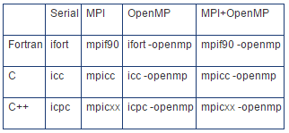
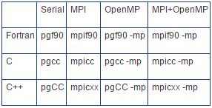
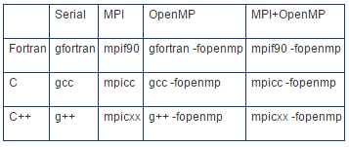
Compiling with Intel, GCC, and PGI
Intel
PGI
GCC

Slide 10
Running jobs on Comet
Comet uses the Simple Linux Utility for Resource Management (SLURM) batch environment for running job in batch mode.
sbatch <jobscript>: Submit Job
squeue –u user1: view all jobs by user1
scancel <jobid>: Cancel a job
Comet has three queues to run your job:

Slide 11
Sample Job Script for MPI and OpenMP
MPI Job-script
OpenMP Job-script
#!/bin/bash
#SBATCH --job-name="hellompi"
#SBATCH --output="hellompi.%j.%N.out" #SBATCH --partition=compute
#SBATCH --nodes=2
#SBATCH --ntasks-per-node=24
#SBATCH --export=ALL
#SBATCH -t 01:30:00
#This job runs with 2 nodes, 24 cores per node for a total of 48 cores.
#ibrun in verbose mode will give binding detail ibrun -v ../hello_mpi
#!/bin/bash
#SBATCH --job-name="hell_openmp"
#SBATCH --output="hello_openmp.%j.%N.out"
#SBATCH --partition=compute
#SBATCH --nodes=1
#SBATCH --ntasks-per-node=24
#SBATCH --export=ALL
#SBATCH -t 01:30:00
#SET the number of openmp threads
export OMP_NUM_THREADS=24
#Run the job using mpirun_rsh
./hello_openmp

Slide 12
Storage Overview on Comet
SSD: 250GB of SSD per compute node that can be accessible during job execution in the directory local to each compute node:
/scratch/$USER/$SLURM_JOB_ID
/oasis/scratch/comet/$USER/temp_project
Parallel Lustre Filesystem: 7PB of 200GB/sec performance storage and 6PB of 100GB/sec durable storage
/oasis/projects

Slide 13
References
http://www.sdsc.edu/support/user_guides/comet.html
https://portal.xsede.org/single-sign-on-hub
https://portal.xsede.org/sdsc-comet
https://www.sdsc.edu/News%20Items/PR100313_comet.html

